Slide 1






SPEECH LANGUAGE PROCESSING
PRESENTED BY
A. Anusha (192472083)
Guided by
Dr. V. K GNANAVEL

Slide 2
Introduction
Speech Language Processing (SLP) is a branch of Artificial Intelligence (AI) that enables computers to understand, process, and generate human speech.
It combines techniques from Natural Language Processing (NLP), speech recognition, and machine learning to interact with users through voice.
SLP converts spoken language into text (Speech-to-Text) and can also convert text into natural speech (Text-to-Speech).
It is widely used in applications such as voice assistants (Siri, Alexa, Google Assistant), call centers, voice search, and speech translation.

Slide 3
What is Speech Language Processing?
Converts speech into text (Speech-to-Text).
Understands the meaning of spoken language.
Generates responses based on user input.
Converts text back into speech (Text-to-Speech).

Slide 4
How Speech Language Processing Works
Speech Input – The user speaks into a microphone, and the system captures the voice signal.
Speech Recognition – The spoken words are converted into text using Speech-to-Text (STT) technology.
Language Processing – The system analyzes the text to understand its meaning, grammar, and user intent.
Response Generation – Based on the user's request, the system generates an appropriate response or performs the required action.
Speech Output – The response is converted into spoken words using Text-to-Speech (TTS) technology and played back to the user.

Slide 5
Components of Speech Language Processing
Speech Recognition (ASR)
Natural Language Understanding (NLU)
Dialogue Management
Natural Language Generation (NLG)
Text-to-Speech (TTS)

Slide 6
Applications
Voice Assistants – Used in Siri, Alexa, and Google Assistant to answer questions and perform tasks.
Speech-to-Text – Converts spoken words into text for dictation, transcription, and note-taking.
Text-to-Speech – Reads text aloud for visually impaired users and navigation systems.
Customer Service – Powers automated call centers, chatbots, and interactive voice response (IVR) systems.
Language Translation – Translates spoken language into another language in real time for communication and travel.

Slide 7
Advantages
Easy Communication – Allows users to interact with computers using natural speech.
Hands-Free Operation – Enables voice control without using a keyboard or mouse.
Saves Time – Speeds up tasks such as searching, typing, and giving commands.
Improves Accessibility – Helps people with visual or physical disabilities use technology more easily.
Supports Multiple Languages – Enables communication and translation across different languages.

Slide 8
Challenges
Accent Variation: Different accents and pronunciations can reduce recognition accuracy.
Background Noise: Noisy environments make it difficult for the system to capture speech clearly.
Speech Ambiguity: Words that sound similar may be interpreted incorrectly.
Multilingual Complexity: Understanding and switching between multiple languages is challenging.
Privacy and Security: Voice data may contain sensitive information and must be protected.

Slide 9
Future Scope
More Accurate Speech Recognition – AI will better understand different accents and speaking styles.
Real-Time Language Translation – Enables seamless communication between people speaking different languages.
Smarter Voice Assistants – Virtual assistants will become more intelligent and provide personalized responses.
Healthcare Applications – Used for medical transcription, patient monitoring, and voice-based diagnosis support.
Human-Like Conversations – Future systems will have more natural, emotional, and context-aware interactions with users.

Slide 10
Conclusion
Speech Language Processing is transforming human-computer interaction.
It enables machines to understand and respond to human speech.
It is widely used in healthcare, education, banking, and smart devices.
Future advancements will make voice communication more natural and intelligent.

Slide 11
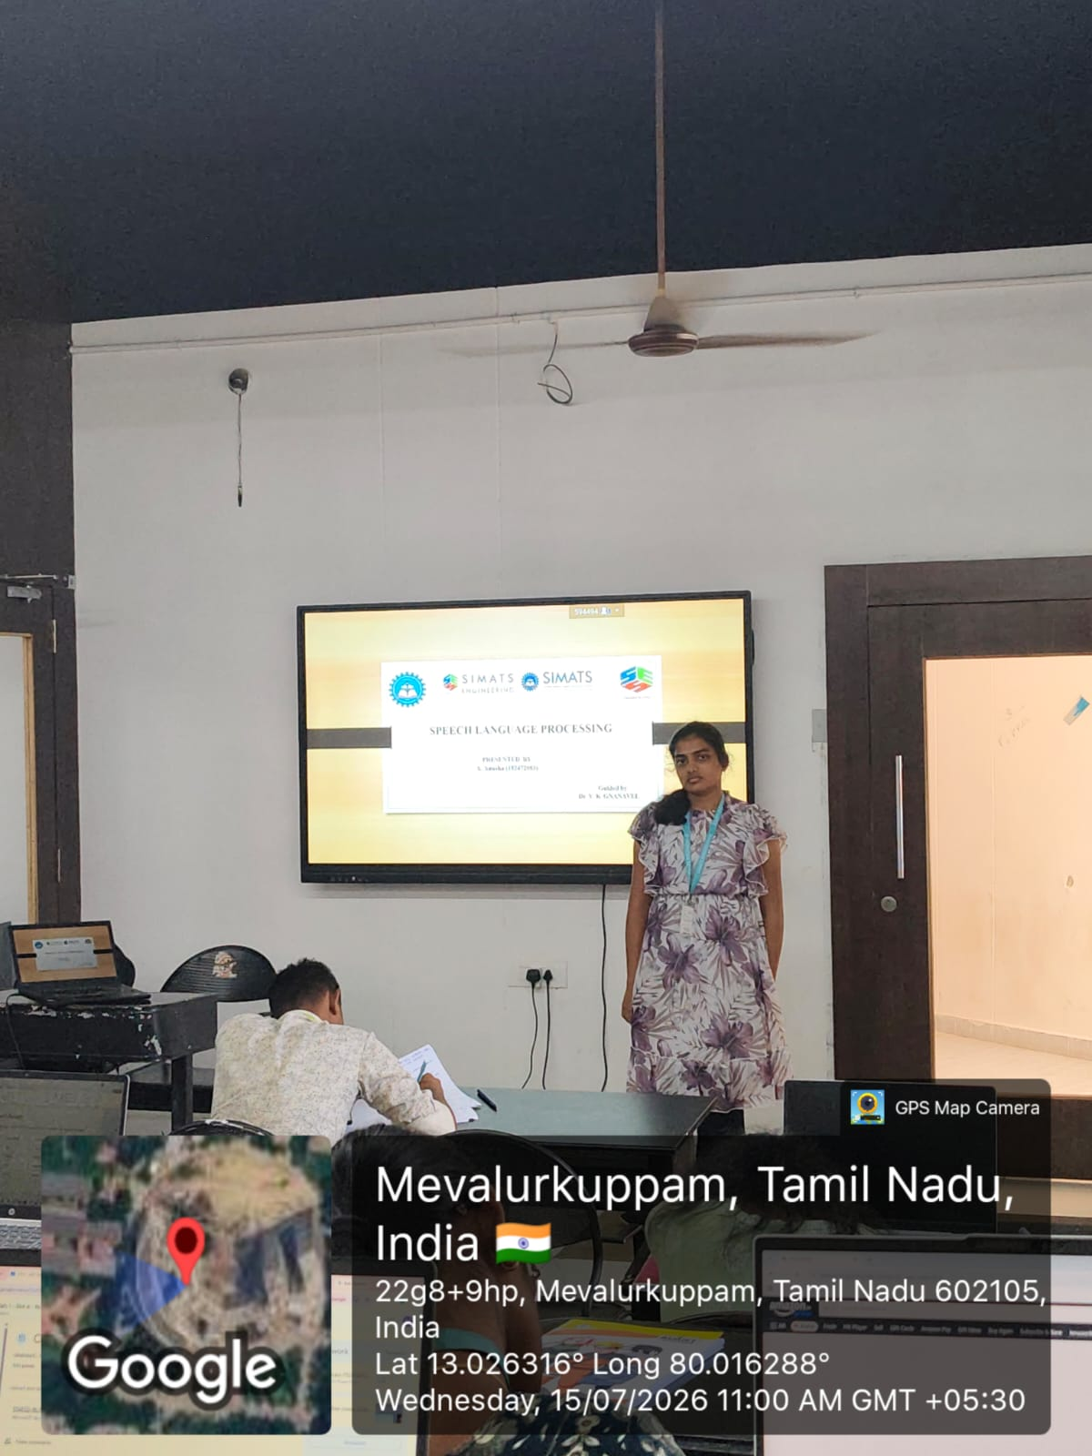
GEO TAG PHOTO

Slide 12
Thank you

